Slide 1



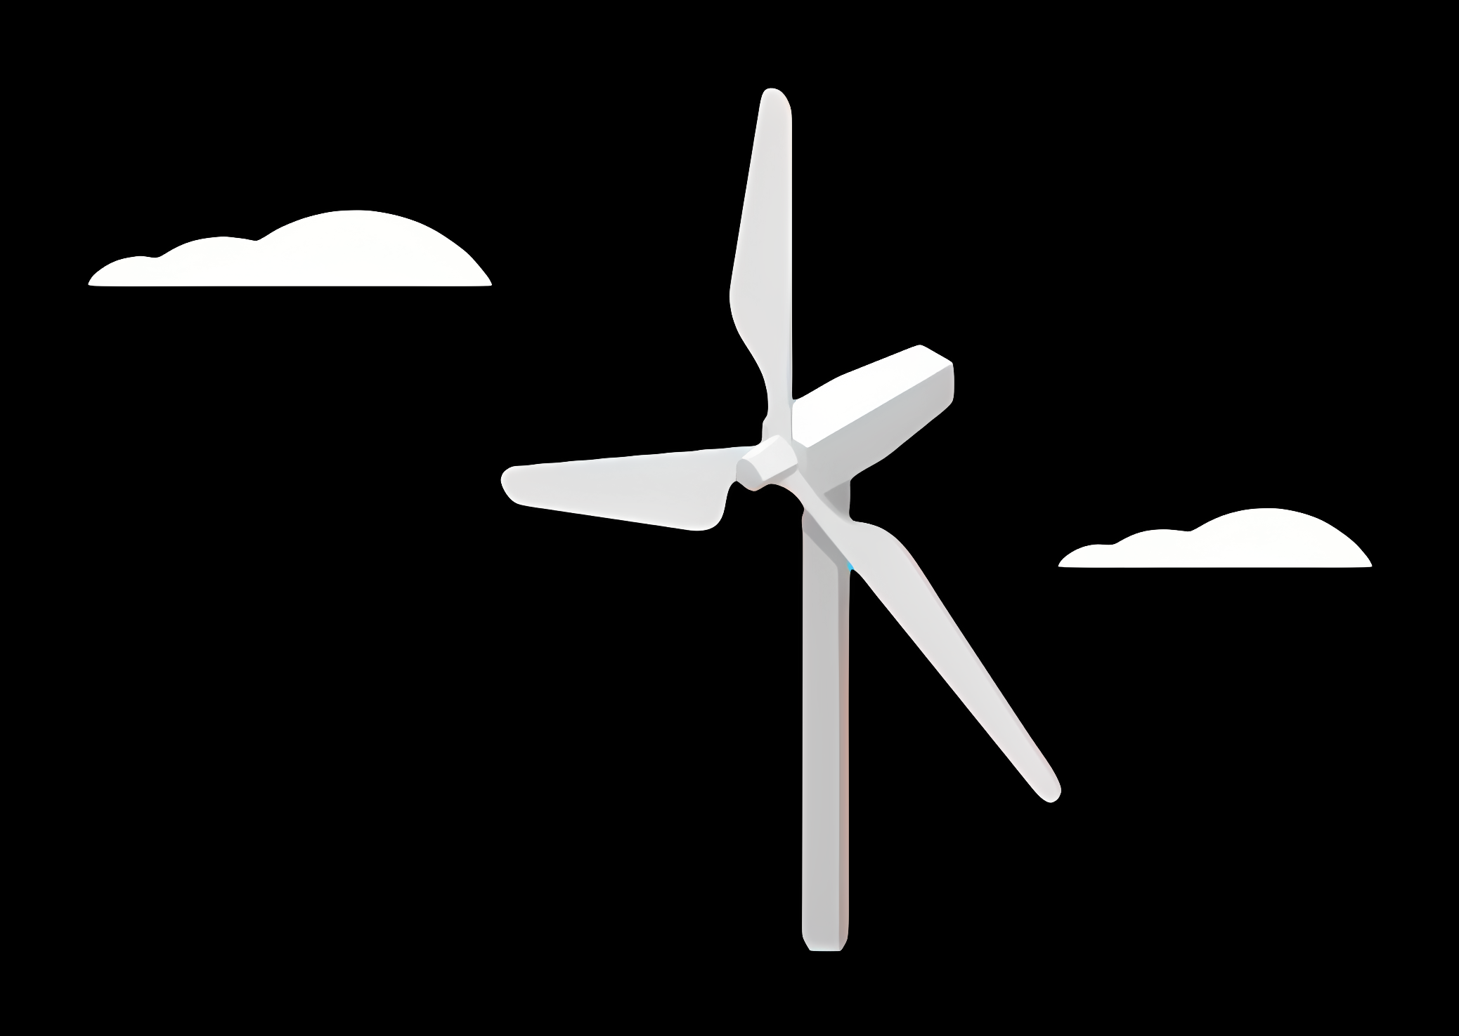
WEC Development Project
Electrical Drivetrain Design for Onshore Wind Turbines – Syria
Date: 10/09/2025
Supervisor: Prof.Dr.Ing.Rajesh Saiju
Group members : Aiswarya Vijayan, Vishranti Shivajirao Patil , Girish Mahadeo Padalkar, Cristina Milene Vergara Hernandez

Slide 2
Agenda
Introduction
Electrical Drive Train Design
Weekly Report
Overview of Syrian Energy Market
Energy Sources & Consumption
Challenges for Generator Selection
Generator Technologies Overview
PMSG vs DFIG Comparison
Final Recommendation & Next Steps
References

Slide 3

Introduction
Project scope:
Designing an optimized electrical wind turbine drivetrain for Syria’s renewable energy market.
Syrian Wind Context
Syria possesses considerable onshore wind resources (Homs, Quneitra, Adra, Hassia).
• Recent tenders announced for 100–200 MW projects.
• Early pilot projects in Quneitra and feasibility studies in Homs.
• Drivetrain design must reflect weak grid conditions and maintenance challenges.
Source: www.ge.com/

Slide 4
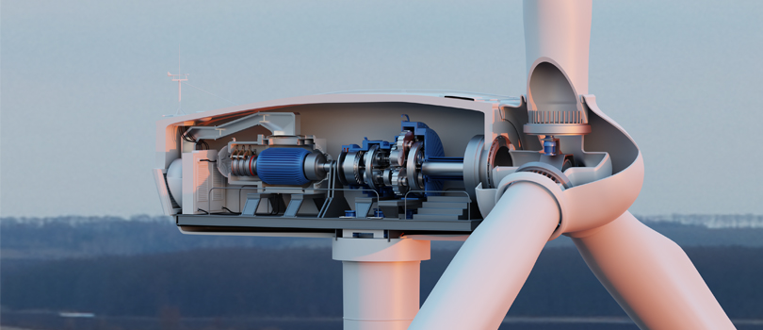
Electrical drivetrain design
Electrical drivetrain components:
Generators.
Transformers.
Converters.
Cables & switch gears.
Integration of the electrical drive train with the grid.
Source: Electrification | Altair

Slide 5
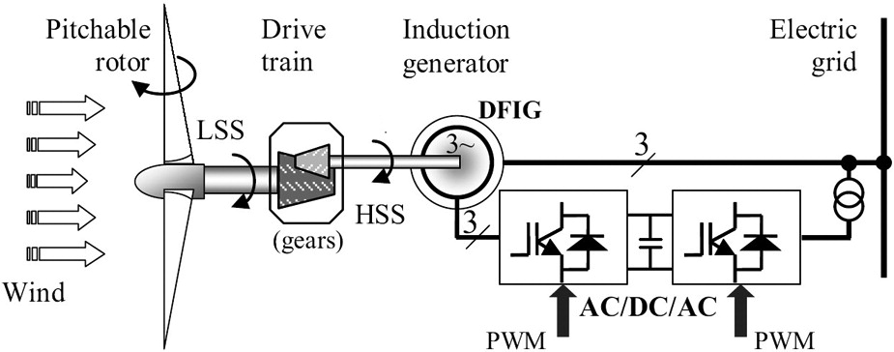
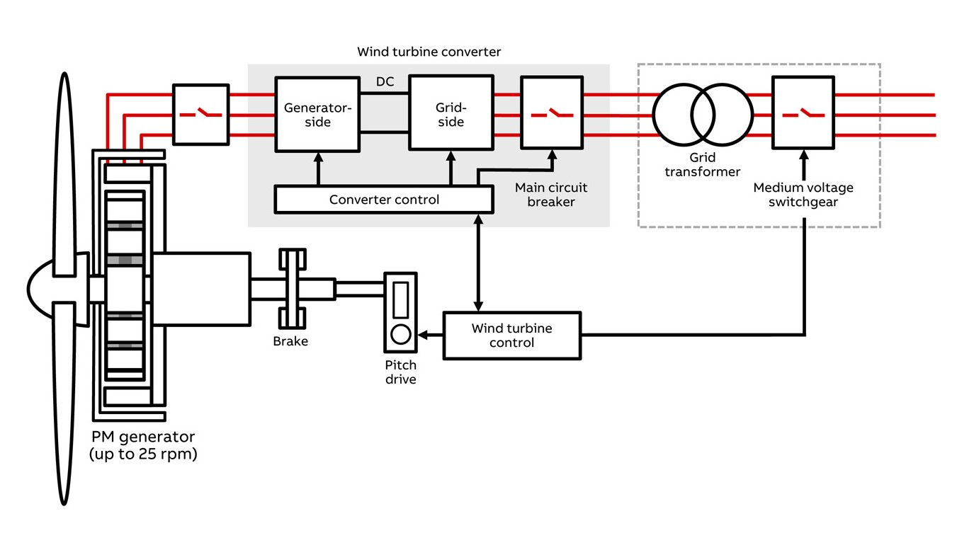
Electrical drivetrain design
Technology choices:
Generators:
DFIG, SG, PMSG, EESG
Converters:
Full converter , partial converter
Source: www.researchgate.net/figure/A-wind-energy-conversion-scheme_fig1_275946980 [accessed 29 Sept 2024]
Source: Low-speed full converter electrical drivetrain package - Wind Power | ABB

Slide 6
Weekly Report
Week 1
Market research on Syrian electricity crisis.
Week 2
Analysis of energy sources and consumption trends.
Week 3
Comparative study of generator technologies.
Week 4
Technical and financial evaluation of PMSG vs. DFIG
Week 5
Final recommendations

Slide 7
Overview of Syria's Electrical Market
• Before the conflict in 2011, over 95% of Syrians had electricity access.
• Due to war, many regions now face blackouts and rely on local generators.
Key issues:
- Damaged power plants and transmission lines
- Fuel shortages and weak infrastructure
- Heavy reliance on public generation systems
Current efforts:
- Grid reconstruction
- Solar and diesel-based microgrids
- International aid and NGO support

Slide 8
Energy Sources and Consumption
Traditional energy mix (pre-conflict):
- Natural Gas: 60–70%
- Oil: ~30%
- A small portion from hydropower
Recent changes:
- More households rely on diesel generators
- Solar panels are popular in off-grid areas
- Renewable energy seen as key for rebuilding

Slide 9
Why This Matters for Generator Selection
What matters when choosing generators for Syria:
- Availability of fuel (diesel is easier to get)
- Generators must be robust and easy to maintain
- Must work in areas with unreliable grids
- Should be ready for hybrid use (solar + diesel)
Looking ahead:
- Hybrid solutions are becoming more common
- Wind and solar can support rural communities

Slide 10
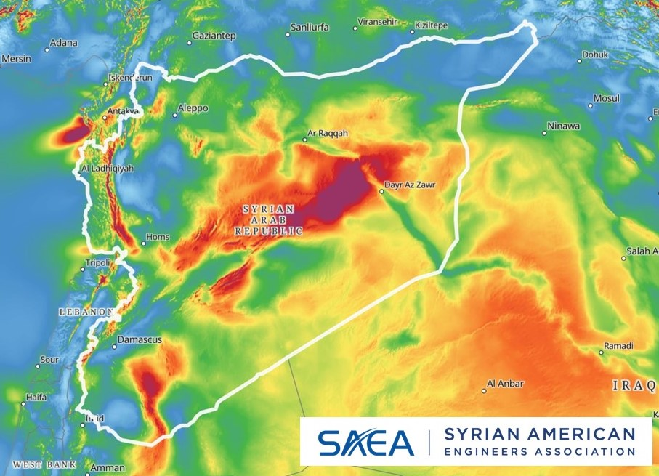
Wind Potential & Targets
• Technical potential estimated ~490 TWh/yr (optimistic scenario).
• GIS and Global Wind Atlas show viable corridors.
• Short-term: 2–5 MW class onshore turbines most feasible.
• Long-term: gradual scaling to utility-scale projects.
Source: https://globalwindatlas.info/
Syria’s wind resource map (Global Wind Atlas).

Slide 11
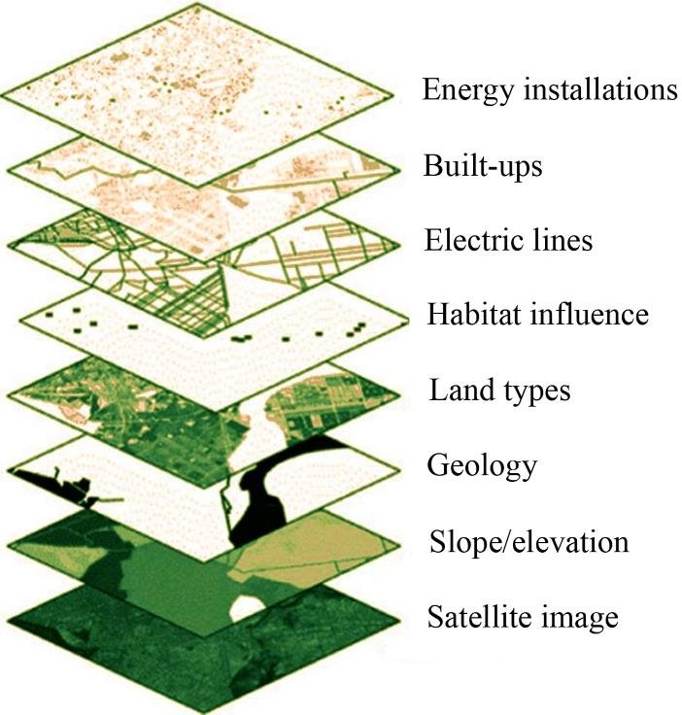
Site Assessment – Key Locations
• Homs, Quneitra, Adra/Hassia identified as suitable.
• Criteria: V@100m ≥ 6 m/s, grid proximity, terrain.
• Environmental: avoid migration routes and seismic risks.
• Transport/logistics constraints for large components.
Source: https://www.researchgate.net/publication/343590768_Integrating_AHP_and_GIS_as_a_decision-making_tool_for_the_optimal_allocation_of_wind_farm_A_case_study_of_Syria
GIS layers for optimal wind farm siting (Habib & Matouk, 2020).

Slide 12
Generators & Selection Criteria for Wind Energy in Syria
Overview of Technologies, Usage, and Strategic Recommendations

Slide 13
Generator type overview
Generator Type | Description | Converter Type
PMSG/PESG | Permanent Magnet or Excited Synchronous Generator | Full-scale
FESG | Field Excited Synchronous Generator | No converter
SCIG | Squirrel Cage Induction Generator | No converter
DFIG | Doubly-Fed Induction Generator | Partial-scale

Slide 14
Reactive Power Capabilities
Generator Type | Reactive Power Capability | Notes
PMSG | ✔️ Excellent (via full converter) | Full control over reactive power
FESG | ✔️ Moderate (via excitation system) | Adjustable via rotor excitation
SCIG | ❌ Limited | Requires external capacitors
DFIG | ✔️ Good (via partial converter) | Effective within converter limits

Slide 15
Key Criteria for Choosing Wind Generators in Syria
• Wind Resource: Favorable zones like Quneitra, Homs, Daraa
• Grid Conditions: Weak grid requires flexible control systems
• Climate: High heat/dust requires durable, low-maintenance tech
• Cost: Low-cost options favored for small/rural setups
• Local Support: Ease of repair and part availability critical
• Scale & Purpose: Domestic vs grid-scale dictates type
• Efficiency: ≥90% preferred for grid-connected systems

Slide 16
Quantitative Comparison
Generator | Weight (tons) | Cost (USD) | Maintenance | Reactive Power
PMSG | ~25 | $300k+ | Low | ±0.65 MVAr
DFIG | ~20 | $200k | Medium | ±0.65 MVAr
SCIG | ~18 | $150k | High | External only
FESG | ~22 | $220k | High | ±0.5 MVAr est.

Slide 17
Comparing DFIG and PMSG for Wind Energy Projects
Technical Comparison:
Reliability: PMSG often uses a direct-drive system, which eliminates the gearbox a common point of failure improving reliability. DFIGs typically require a gearbox.
Grid Control: Both DFIG and PMSG can be used for grid-connected systems. However, the PMSG's full-scale inverter offers more robust control for reactive power and fault ride-through, which is beneficial for weak grids.
Efficiency: PMSG's lack of a gearbox and rotor excitation losses contributes to its high efficiency, especially at partial loads. An efficiency of 90% or more is preferred for grid-connected systems.

Slide 18
Comparing DFIG and PMSG for Wind Energy Projects
Financial Comparison:
Initial Cost: The PMSG has a higher initial capital cost due to the use of rare-earth magnets and a full-scale power converter. The DFIG's partially rated converter makes it a lower-cost option upfront.
Long-Term Costs (LCOE): The lower maintenance costs and higher efficiency of the PMSG can lead to a lower lifetime cost of energy, making it a more financially viable long-term solution.

Slide 19
Our Recommendation: PMSG for the Syrian Project
Why PMSG is the Better Choice:
Reliability is Critical: Given the challenges with local support and part availability in Syria, the PMSG's higher reliability and lower maintenance needs are paramount. This is a crucial factor, especially in a climate with high heat and dust.
Adaptability to Weak Grids: The Syrian electrical infrastructure is facing reconstruction , and the grid is weak. The PMSG's excellent grid control makes it a robust choice that can handle these conditions effectively.
Efficiency and Durability: PMSG generators meet the preferred efficiency standard of over 90% for grid-connected systems. Their durable design is well-suited to the local climate.
Long-Term Financial Viability: While the initial cost may be higher , the long-term benefits of reduced maintenance and higher efficiency will lead to a more sustainable and economically sound project.

Slide 20
Conclusion & Next Steps
The Permanent Magnet Synchronous Generator (PMSG) is the recommended generator type due to its reliability, high efficiency, and robustness against weak grid conditions and harsh climate.
Actionable Steps:
Include dust-proof design and heat management in the specifications for the generators.
Target PMSG with cooling and inverter systems for future utility projects.

Slide 21
References
Global Wind Atlas. (n.d.). Syria wind resource map. Retrieved September 2, 2025, from https://globalwindatlas.info
Renewables Now. (2025, August 4). Syria seeks developers for wind farm project of up to 200 MW. Retrieved from
https://renewablesnow.com/news/syria-seeks-developers-for-wind-farm-project-of-up-to-200-mw-1279598/
Syrian Green Building Council. (n.d.). Syria wind potential map and speed data. Retrieved September 2, 2025, from https://www.syriangbc.org/en/ed/wind.htm
Habib, M., & Matouk, A. (2020). Integrating AHP and GIS as a decision-making tool for optimal wind farm allocation: A case study of Syria. ResearchGate
https://www.researchgate.net/publication/343590768
Al Jamil, A., & Sidorenko, G. (2020). Syria’s wind resources: Outlook for the future. E3S Web of Conferences.
https://www.e3s-conferences.org/articles/e3sconf/pdf/2020/17/e3sconf_ktti2020_06032.pdf
IEC. (2020). IEC 61400 series – Wind turbine standards.
https://en.wikipedia.org/wiki/IEC_61400
Okedu, K. E., & Muyeen, S. M. (2022). "Comparative Performance of DFIG and PMSG Wind Turbines during Transient State in Weak and Strong Grid Conditions Considering Series Dynamic Braking Resistor." Energies, 15(23), 9228.
https://www.mdpi.com/1996-1073/15/23/9228
Al-Jamil, A., & Ahmad, K. (2020). "Syria's wind resources: Outlook for the Future." E3S Web of Conferences, 157, 06032. https://www.e3sconferences.org/articles/e3sconf/pdf/2020/17/e3sconf_ktti2020_06032.pdf
Drouet, C., Bacha, S., & Bacha, E. (2018). "Reliability comparison of direct-drive and geared-drive wind turbine concepts." ResearchGate. https://www.researchgate.net/publication/43033891_Reliability_comparison_of_direct-drive_and_geared-drive_wind_turbine_concepts
Okedu, K. E. (2021). "Comparative Study of the Effects of Machine Parameters on DFIG and PMSG Variable Speed Wind Turbines During Grid Fault." Frontiers in Energy Research, 9, 681443.
https://www.frontiersin.org/journals/energy-research/articles/10.3389/fenrg.2021.681443/full

